Slide 1
The Expert Edge What to Know Now in the Public Sector and SLED Marketplace
May 2021
Helpful Tips for Today’s Event:
Audio: Sound will stream through your computer speakers (no dial-in #)
Questions for presenter: Use the Q&A widget and we will respond live during the Q&A session or after the webinar
Follow Up: An on-demand recording of this webinar will be sent tomorrow.
Browser: For the best experience, use Chrome. Avoid Internet Explorer
Notes:
Event Show Flow
Activity
Timeframe
Moderator/host (Dena K.) introduces the event series, the topic of today’s event and each individual panelist
2 minutes
Question 1:
3-4 minutes
Question 2:
3-4 minutes
Question 3:
3-4 minutes
Question 4:
5-6 minutes
Open Forum -- Audience Q&A:
20-24 minutes
Thank you and closing remarks; promote June event (Moderator)
1 minute
Event Run-time
37 – 45 minutes total

Slide 2
What You Can Expect From Today’s Discussion
Understand the building blocks for a successful SLED practice – with guidance form leaders in Tech Data’s Public Sector vertical
Get the key to unlocking contracts and other immediate sales opportunities
Hear a summary of recent federal stimulus funding
Ask questions in real-time (using the Q&A panel)
Walk away with information and skills that you can apply toward your public sector practice
Notes:
Dena’s Notes –
Hello, and welcome to The Expert Edge – a new, monthly live cast brought to you by Tech Data and LevelUp, our go-to source for training and enablement.
Each month, we’re hosting a panel of our foremost subject matter experts in a lively discussion. Together, they’ll share valuable insights about technology solutions, the channel and business-building opportunities.
My name is Dena K and I lead the content team with Tech Data Agency. I’ll be moderating today’s discussion, in which we’ll bring you best practices in the realm of the public sector vertical.

Slide 3
Meet Today’s Panelists
Notes:
Let’s meet today’s panelists!

Slide 4
Let’s start with a lay of the land. Tell us about the public sector market today.
QUESTION #1

Slide 5
5000+
Contract Responses
10,000+
Public Sector Customers
GSA
Contract Holder
$947M
SLG Revenue – FY21
$4.8B
S&L, Education,
Federal
$1.7B
EDU Revenue – FY21
14,000
Socio-Economic Partner Classifications
260,00+
Public Sector Unique EU Locations Served

Slide 6
Now that we’ve established the need for public sector solutions, what steps can reseller partners take to start growing their public sector business?
QUESTION #2

Slide 7
Steps to Public Sector Success
Building Contacts
Solutions Approach
Capture Engine
Public sector sales success requires a foundational understanding of procurement processes, contract vehicles and agency decision making.
States and Agency Targets
Contract Strategy
IT Budgets and Priorities
Tech Data can help you design, build, and implement a sustainable sales model that leads to public sector success.
Public sector selling differs greatly from commercial selling in funding cycles, project implementation and chains of command and control.

Slide 8
Steps to Public Sector Success
Things to consider:
Start with an honest assessment of your public sector industry capability
Identify what in-house expertise you have around contracts, solicitations, legislation
Leverage all publicly available data
Consider dedicating reps specific to PS
Create a library of “past performance”
Understand and prepare for potential extended opportunity timelines
Lead with use-cases that align to published budget priorities
Stress your local connection and diversity status
Building Contacts
Solutions Approach
Capture Engine
States and Agency Targets
Contract Strategy
IT Budgets and Priorities

Slide 9
What type of contract solution services does Tech Data offer?
QUESTION #3

Slide 10
Tech Data Contract Solution Services
With our combined Public Sector knowledge and resources, we help you:
WIN
Agent
TEAM
by getting you direct access to the prime contract vehicles you need so you start selling to the public sector today
by securing the strategic vehicles that align with your objectives so you can run your own public sector infrastructure
by connecting you with a network of channel partners that can bring your solution to market in dynamic and highly targeted ways

Slide 11
Finally, take us deeper into some of the market drivers in the public sector today.
QUESTION #4

Slide 12
Education Market Drivers

Slide 13
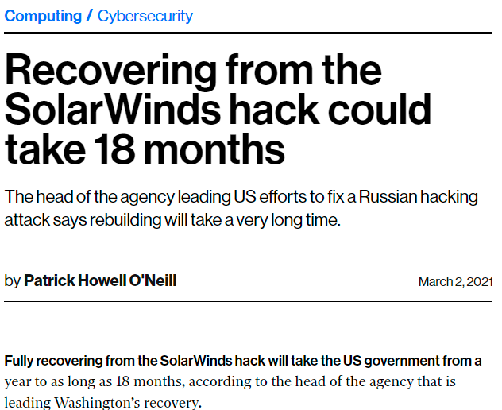
State and Local Gov Market Drivers

Slide 14
American Rescue Plan
The U.S. House of Representatives on March 10, 2021, passed the Senate-amended H.R. 1319, the American Rescue Plan (ARP). The ARP provides $1.9 trillion in additional relief to respond to the novel coronavirus (COVID-19). This follows the enactment of nearly $4 trillion in COVID relief in 2020. ARP includes provisions on aid to state and local governments, hard-hit industries and communities, tax changes affecting individuals and business, and other provisions.
Extended Timeline -- Funds must be used NLT Dec 31, 2024
Funding Summary
States $195.3B
Local Governments $130.2B
Territories $4.5B
Tribal Governments $20B
K12 Schools $128.5B
Higher Education $39.6B
Emergency Connectivity $7.2B
Vaccine Distribution and Communication $7.5B
COVID-19 Testing $46B
State Based Marketplace Modernization $20M
Federal Transit Grants $30B
Airport Relief $8B
Reference Links to American Rescue Plan (ARP)
https://www.congress.gov/bill/117th-congress/house-bill/1319
https://www.hklaw.com/-/media/files/insights/publications/2021/03/americanrescueplankeyprovisions.pdf?la=en
https://www.govtech.com/budget-finance/Stimulus-Package-Means-Billions-for-State-and-Local-Tech.html
Solutions

Slide 15
Public Sector Resources
We have tools and resources available to assist in your efforts to be successful in public sector.
Tech Data Public Sector Website
https://www.techdata.com/techsolutions/publicsector/default.aspx
Level Up- Public Sector
https://levelup.techdata.com/verticals/public-sector
IoT Solution Catalog
https://iot.techdata.com/index.html
Diversity Database
Over 14000 diversity classifications to assist with teaming.

Slide 16
To learn more, email us at publicsector@techdata.com
or contact the Tech Data Public Sector team at 800‐436‐5353.
You can also visit our website at https://tdcontent.techdata.com/techsolutions/publicsector/default.aspx

Slide 17
Audience Questions
Now is Your Opportunity - Ask Our Thought Leaders What You Want to Know.
Notes:
Ok, now we’ll open the floor to all of you. Please post your questions in the Q&A panel.
Back-pocket Qs from Terry and Tim:
1. For a partner that may just be starting out in public sector, what is the one thing that you would suggest we focus on to help ensure success?
2. IS it too late to try to take advantage of the recent federal stimulus waves that were released?
3. There are a lot of tools out there that provide info on current market solicitations. Is this a successful way to yield results and to win new business?
4. We are a reseller servicing multiple regions—what would you suggest as a contract strategy since we are supporting multiple geographies?
5. You spoke about your efforts around diversity designations – how would we engage with Tech data to learn more about how we could take advantage of the database you have built?

Slide 18
Thank You for Joining Us
We hope to see you at next month’s session
View more great content at levelup.techdata.com
Notes:
This brings us to the conclusion of today’s Expert Edge event.
Thank you again to our panelists – Tim and Terry – and thank you to our audience for joining.
We’ll be back next month with more busines insight at The Expert Edge. In the meantime, you can view more great content at levelup.techdata.com.

